Slide 1
Equity in Academia: A Critical Discourse on Scholarly Publishing
Lisa DeTora
Hofstra University, United States

Slide 2
Introduction
This talk provides an overview of some themes of equity and how they may be understood to impact scholarly publishing
Although scientists are actively engaged in improving equity and inclusion, critical frameworks from other fields in the social sciences and humanities can also provide important insights
Speaking as a scholar involved in biomedical publications who also does scholarship in rhetorical studies, communication, and health humanities, I will lay out some questions that may be interesting for the ACSE community
Your insights and feedback are highly welcome

Slide 3
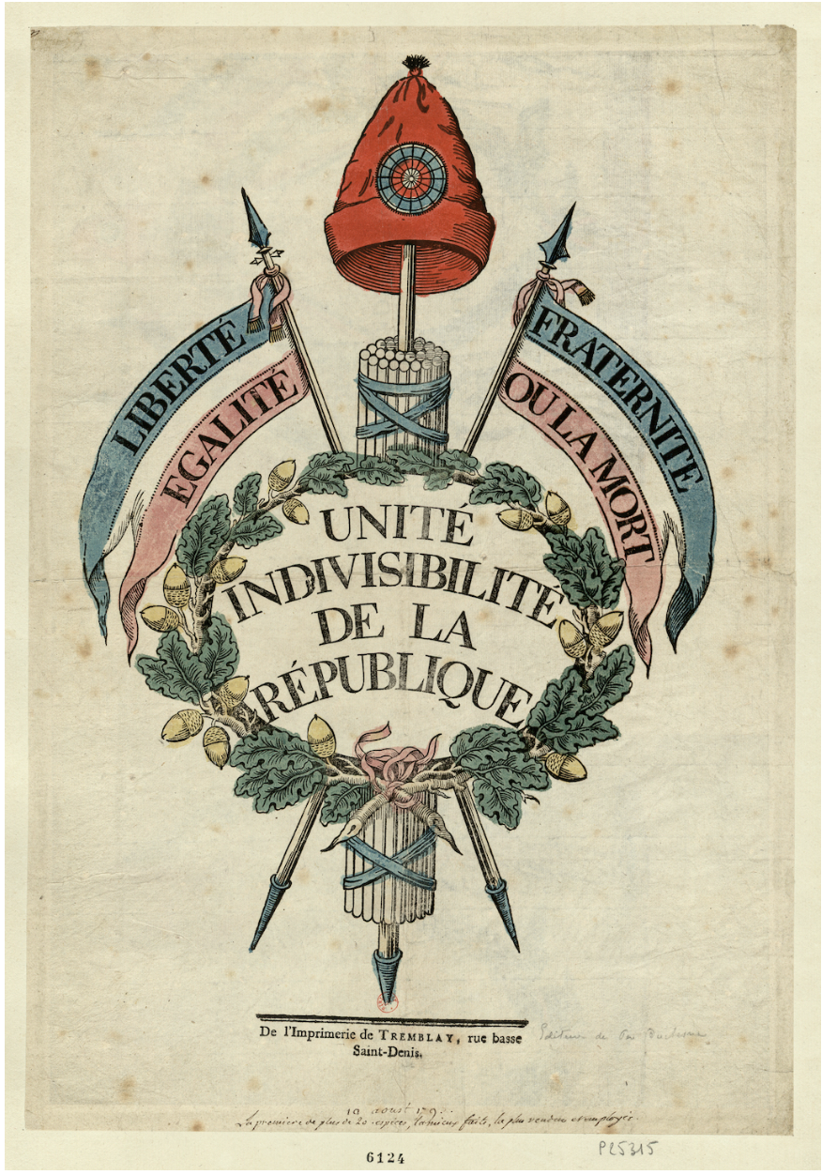
Equity
The notion of equity generally seems to have derived from democratic systems of government that allow various groups to have a voice and seek representation
However, long histories of colonialism and concentrating educational and economic resources in certain regions create ongoing obstacles to achieving equity
Equity in scholarly publishing is a key need not only for general representation but also to allow access to the means of reducing inequities
A problem exists in that the means of entering scholarly culture are implicit, indirect, and implied

Slide 4
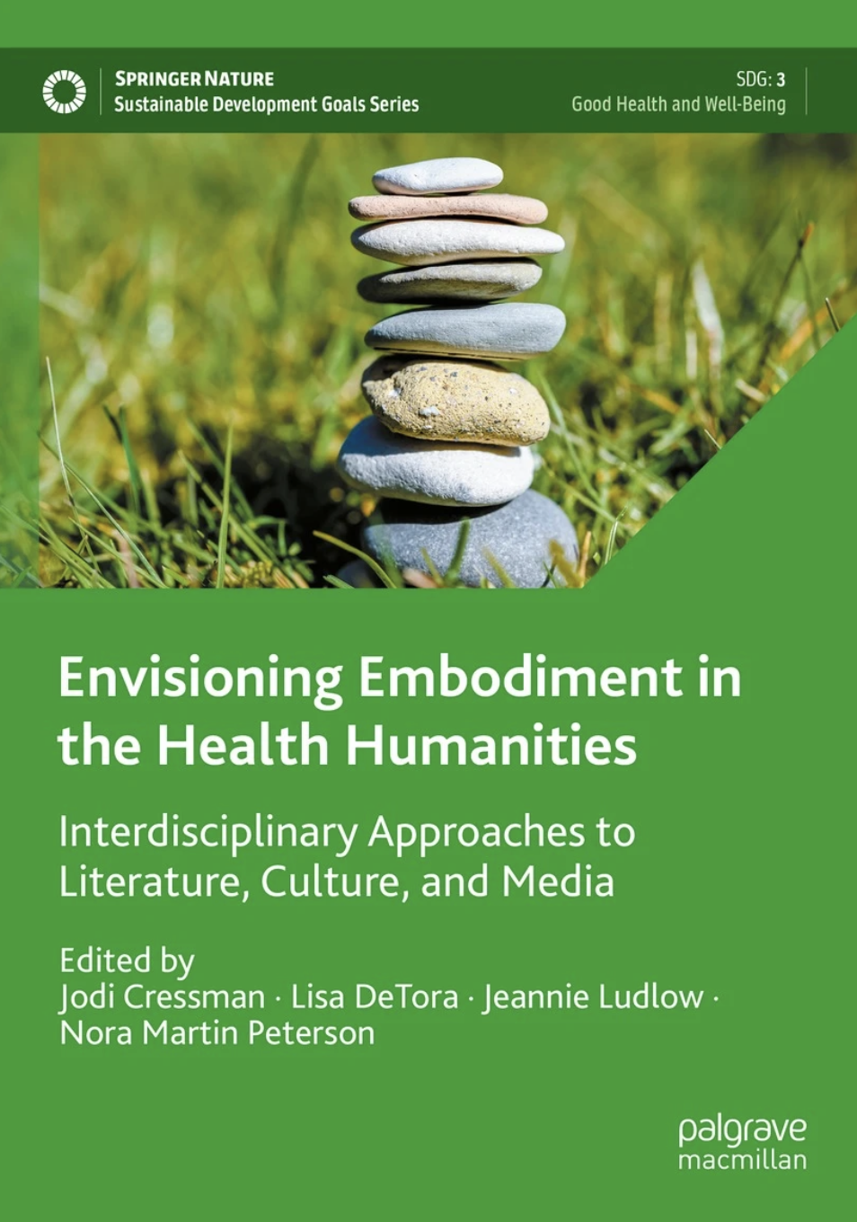
Publishing Endeavors and Sustainable
Development Goals
The seventeen United Nations Sustainable Development Goals seek equity in various areas, significantly:
Health and well-being (SDG 3)
Education (SDG 4)
Gender (SDG 5)
Reduced inequality (SDG 10)
Various publishers have encouraged authors and editors to contribute to work to achieve these goals
Notably Springer/Palgrave MacMillan
SDG Series includes social science, humanities, and STEM research

Slide 5
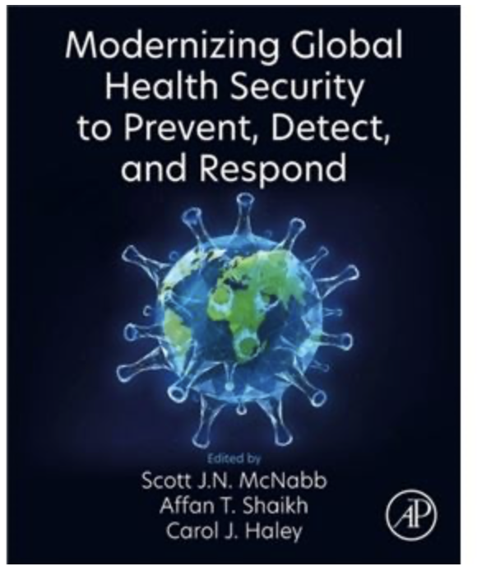
Global Health Security
Recent book recommends addressing equity and effects of colonialism as necessary elements of an ethics framework
This framing is necessary in part because existing ethics frameworks emphasize autonomy, which is a site of privilege
Public health interventions compound problems of inequity
Inequity can endanger public health

Slide 6
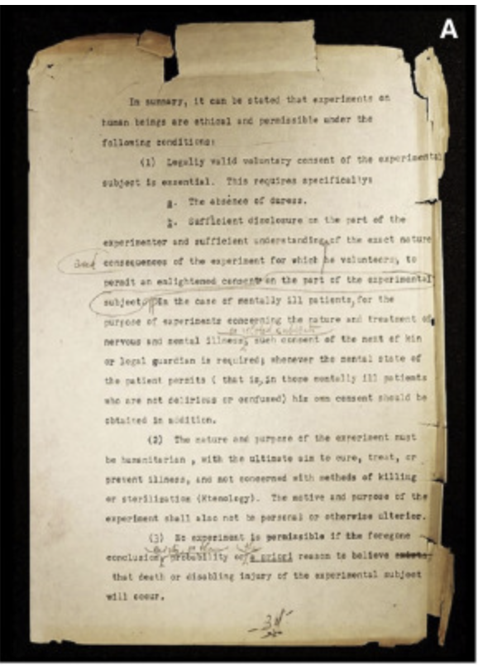
Autonomy
Autonomy is a Western concept, described in documents like
Nuremberg Code (c. 1946)
Declaration of Helsinki (c. 1964)
Belmont Report (c. 1978)
These documents reacted against research abuses in Europe and the United States
Written, informed consent is a remedy that ironically contributes to other forms of inequity
Equity would suggest honoring different perspectives
Experts in pediatric informed consent suggest that in cultures where decisions are taken on a family basis, the idea of autonomy is confusing

Slide 7
Authorship and Equity
Individual authorship, like autonomy, is a Western concept
May denote taking responsibility for the work –or- making the work
Different concepts of collaboration and respect can affect the notion of who “contributed”
Authorship criteria that outline ‘intellectual’ contributions may not agree with cultural values
Taxonomies do not align closely with authorship
Contributorship models may make it difficult to set boundaries
Misunderstanding AI creates further complications
Algorithms do not “author”
Equity requires access to
education, funding, academic positions, peer review

Slide 8
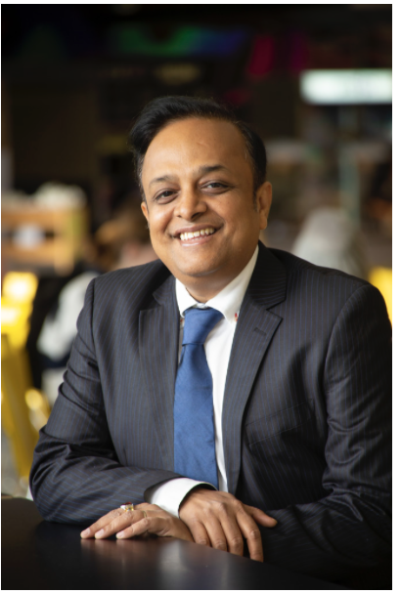
Multidisciplinary Perspectives
Communications scholar Mohan Dutta suggests starting with community values prior to communicating healthcare information or beginning research
This social science perspective—culture centered approaches—recognizes that norms in certain cultures create systems of inequity that can invisibly limit access to resources and agency
Recognition is needed of interactions between
Structure
Culture
Agency
Centering human concerns honors all perspectives

Slide 9
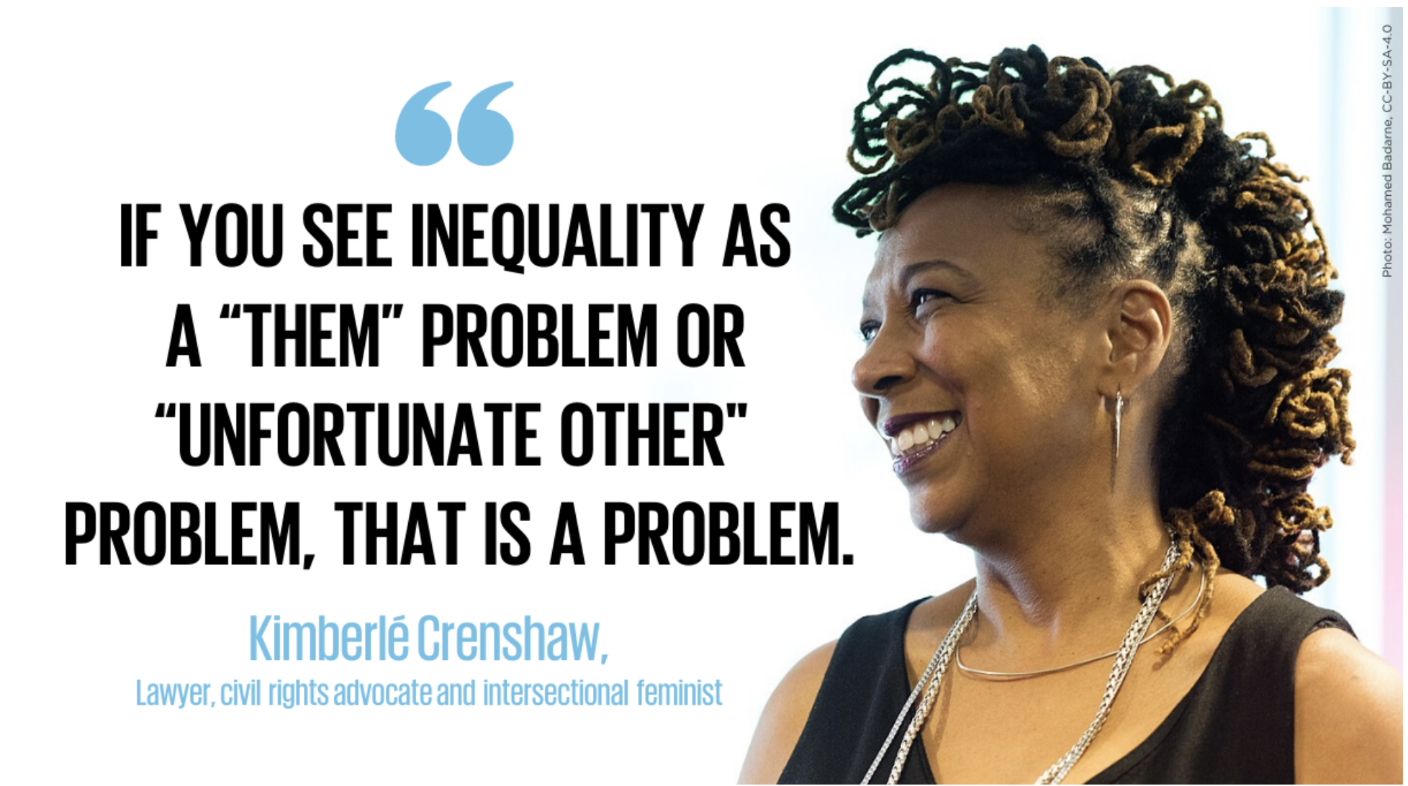
Intersectionality
Legal scholar Kimberle Crenshaw describes the ways that identities compound inequity
Race
Gender
Ethnic identity
Language practices
Education
Social class
Considering the intersectional identities of various people and communities can enhance culture-centered approaches
Norms in certain cultures create systems of inequity that can seemingly invisibly limit access to resources and agency
and equity

Slide 10
What’s Needed Next?
Respect ongoing initiatives
Scholarly publishing groups address various kind of inequity
World Association of Medical Editors
Council of Science Editors
International Committee of Medical Journal Editors
Good Publication Practice
Regulatory advice also considers representation
International Committee on Harmonisation of Technical Requirements for Pharmaceuticals for Human Use
Patient inclusion
Lay summaries as required under the European Code
These endeavors are concentrated in locations that still benefit from past histories of colonialism
Viewpoints are needed from groups like ACSE

Slide 11
Authorship Equity
Authorship equity can be enhanced by
Understanding cultural values and how they affect research practices
Expanding access to education, grants, and roles in publishing
Clarifying editorial rules and author criteria to be more culturally inclusive
Considering professional roles as well as personal identities as likely to be overlooked

Slide 12
References/Further Reading
Barthes, R. “Death of the Author” Aspen, no. 5–6, 1967.
Barthes R. Image, Music, Text. Hill and Wang; 1977
Council of Science Editors. https://www.councilscienceeditors.org
CRediT Author Statement: https://www.elsevier.com/researcher/author/policies-and-guidelines/credit-author-statement
Crenshaw, K. Mapping the Margins: Intersectionality, Identity Politics, and Violence against Women of Color (1994). In R. K. Bergen, J. L. Edleson, & C. M. Renzetti, Violence against women: Classic papers (pp. 282–313). Pearson Education New Zealand.
Department of Health, Education, and Welfare, & National Commission for the Protection of Human Subjects of Biomedical and Behavioral Research (2014). The Belmont Report. Ethical principles and guidelines for the protection of human subjects of research. The Journal of the American College of Dentists, 81(3), 4–13.
DeTora L. M. (2022). Mapping author taxonomies and author criteria: good practices for thinking through complex authorship situations. Current medical research and opinion, 38(9), 1559–1565. https://doi.org/10.1080/03007995.2022.2083403
Dutta, M. J. (2018). Culture-centered Approach in Addressing Health Disparities: Communication Infrastructures for Subaltern Voices. Communication Methods and Measures, 12(4), 239–259. https://doi.org/10.1080/19312458.2018.1453057
Foucault, Michel, 1926-1984. The Foucault Reader. New York: Pantheon Books, 1984
ICH Official Website: https://www.ich.org
International Committee of Medical Journal Editors. https://www.icmje.org
Nabyonga-Orem J. Equity in Scientific Publication. Health Serv Insights. 2022 May 21;15:11786329221100307. doi: 10.1177/11786329221100307
The Nuremberg Code (1947) BMJ 1996; 313 :1448 doi:10.1136/bmj.313.7070.1448
Promoting Global Clinical Research in Children. https://mrctcenter.org/project/promoting-global-clinical-research-in-children/
Regulation (EU) No. 536/2014, Article 371 (”EU CTR”)
United Nations. The 17 Goals. https://sdgs.un.org/goals
World Association of Medical Editors: https://www.wame.org
World Medical Association. World Medical Association Declaration of Helsinki: Ethical Principles for Medical Research Involving Human Subjects. JAMA. 2013;310(20):2191–2194. doi:10.1001/jama.2013.281053

